Slide 1
Deep Learning for Audio: Challenges & Opportunities
Vivek Kumar, Director Applied AI,
Dolby Laboratories
February 28, 2019
Notes:
Hi Everyone, my names Vivek I come from a land far far away🔴

Slide 2
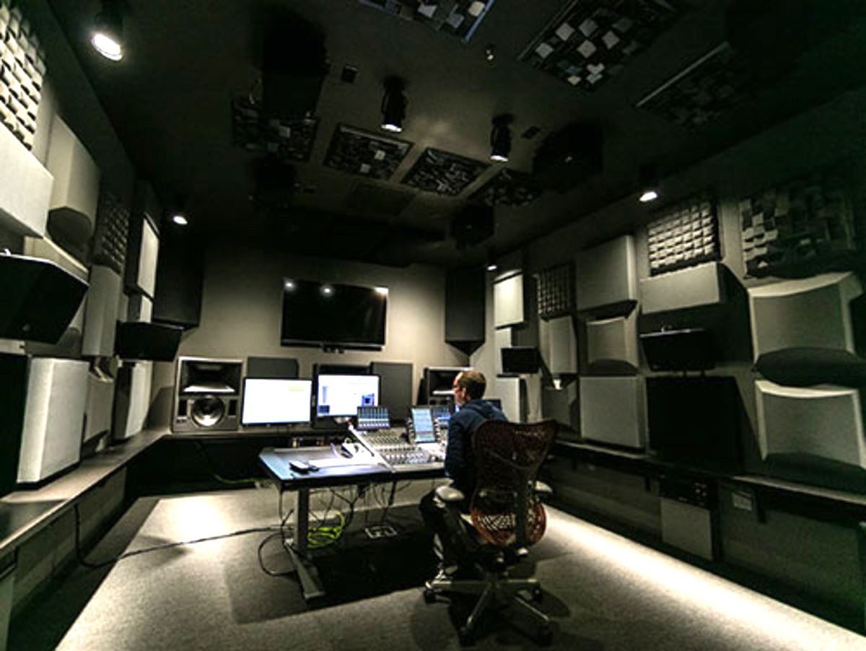
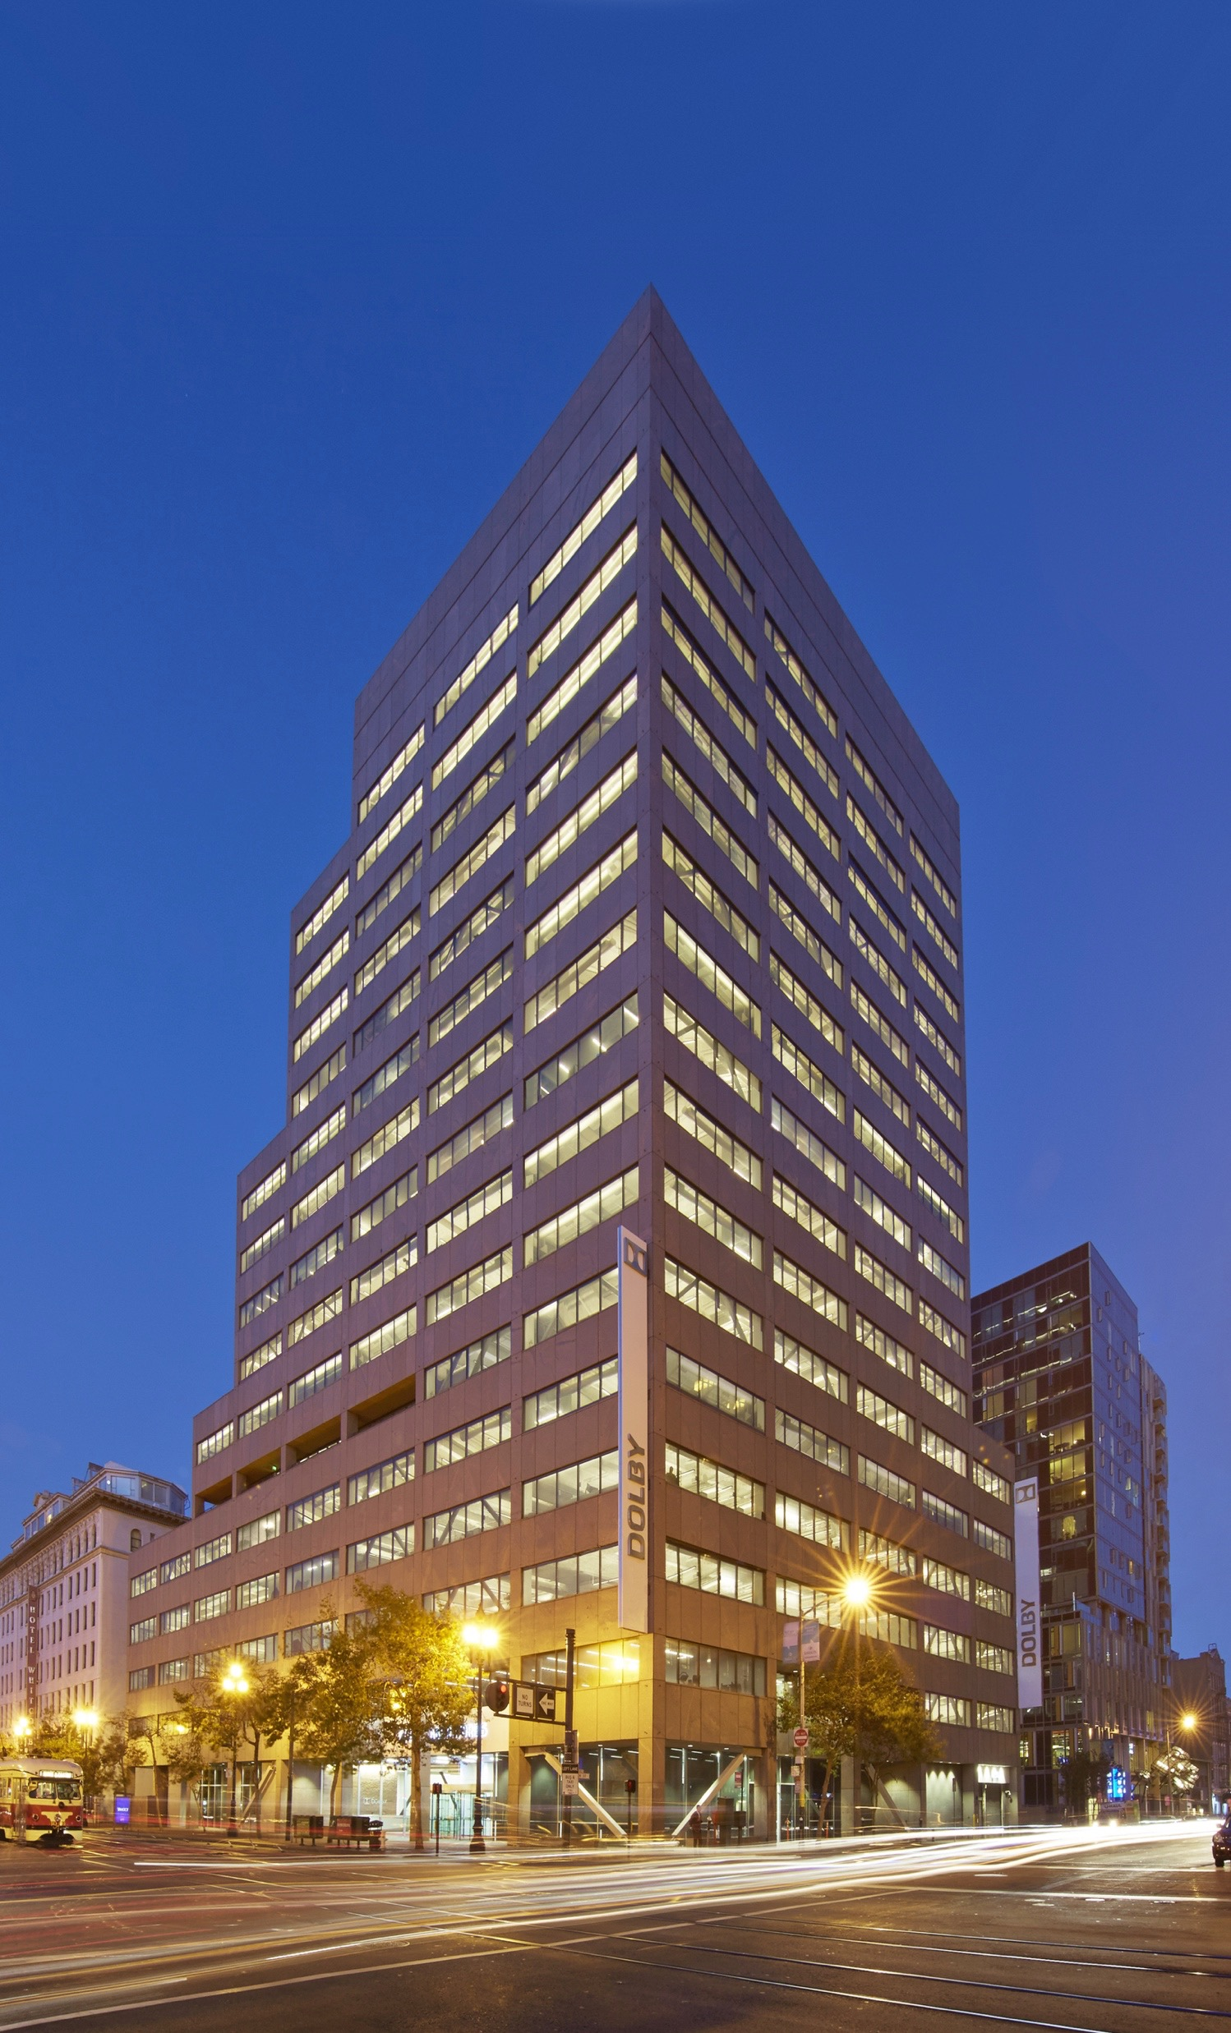
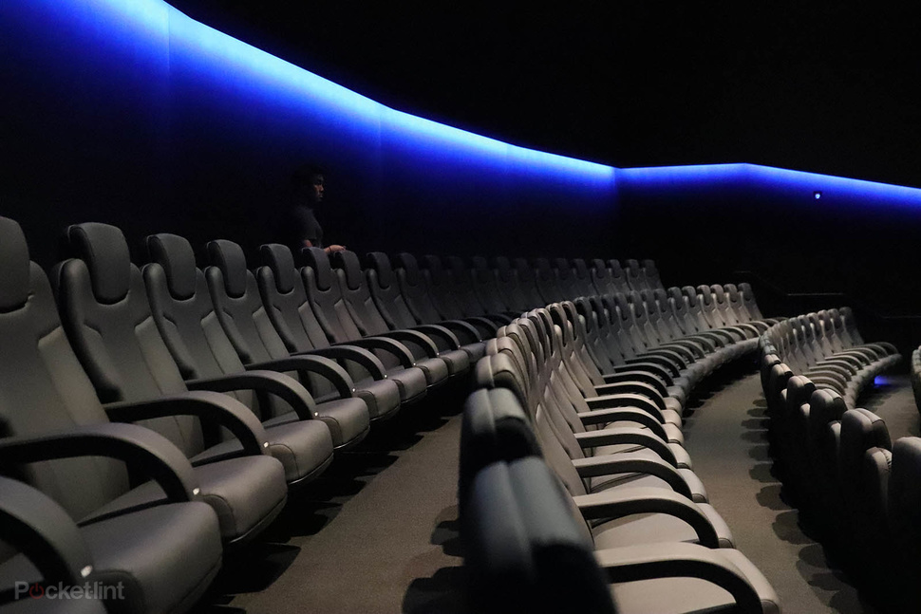
Over 100 Labs !
Notes:
From across the bridge.
This is our corporate headquarters in San Francisco 🔴
We have over 100 labs and listening rooms in the building
- which shows how seriously we take research 🔴
and our largest lab is 250 seat Dolby Cinema theater with worlds best audio and video system 🔴

Slide 3
Applied AI
Creating technologies based
on machine/deep learning
Notes:
A little bit about me. I have been in Dolby for 10 years.
I lead a team of researchers and developers focused on creating technologies based on Deep Learning.
Our primary focus is on Audio and Speech, although we work on vision based projects as well.
Prior to this, me and serval members of the team were working on working on our core products like Dolby Digital + & Dolby TrueHD
🔴
<1 minute>

Slide 4
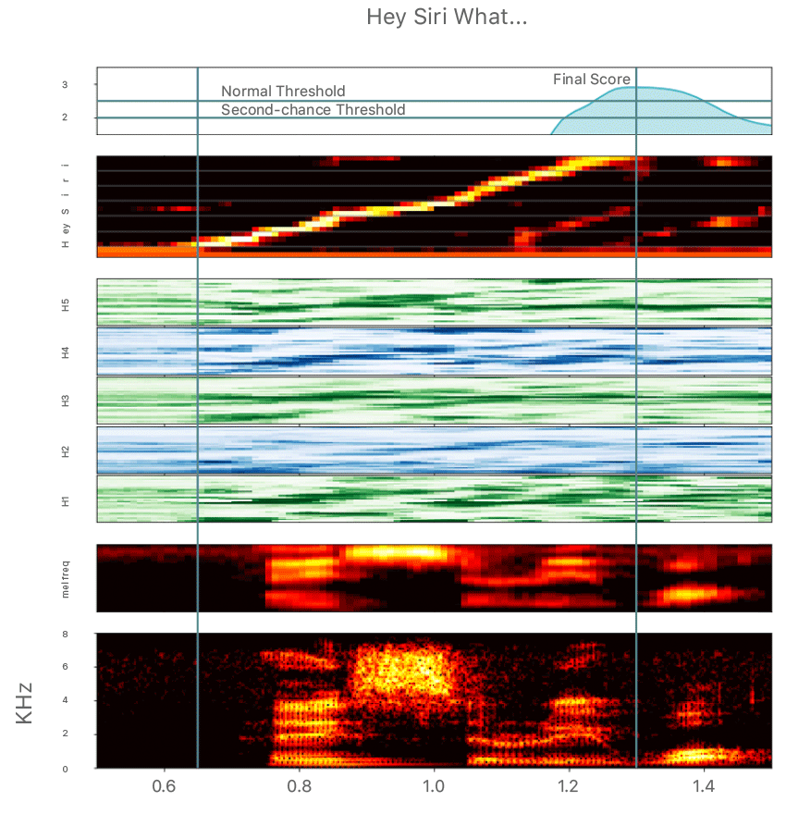
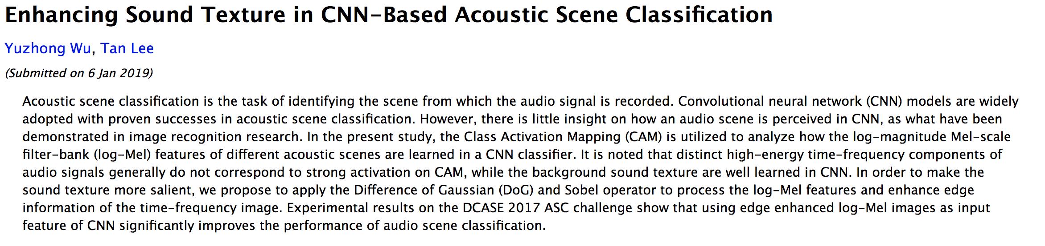
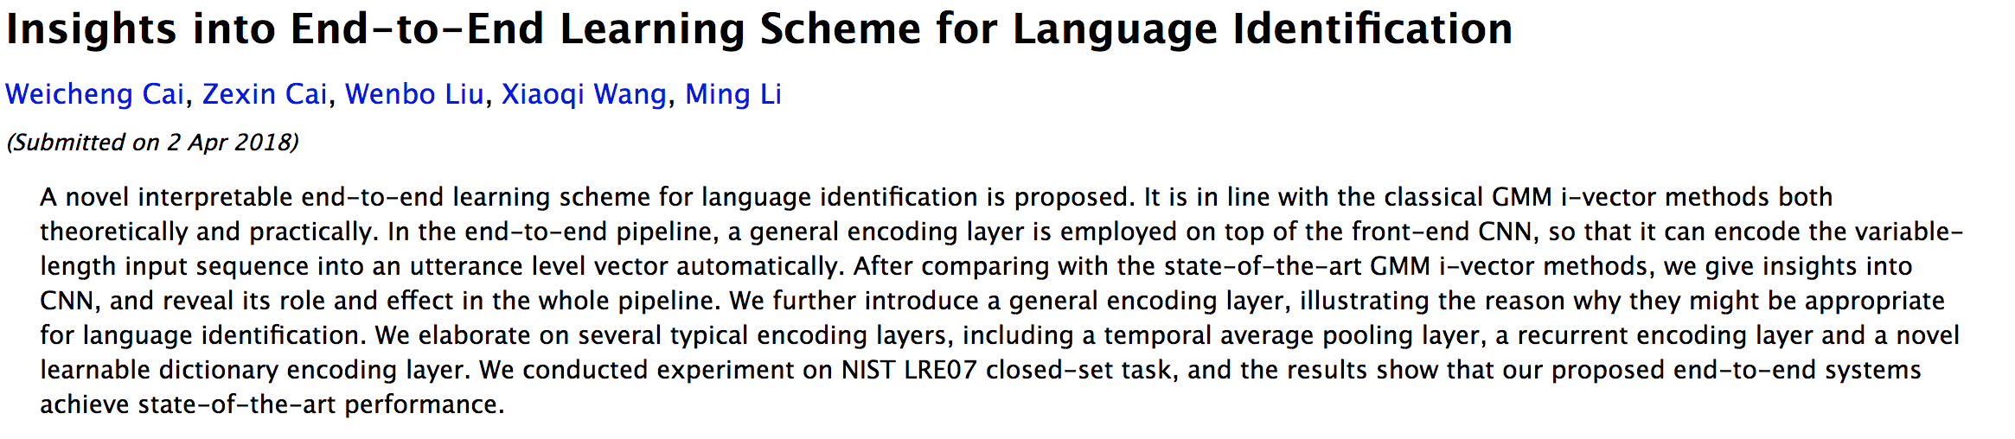
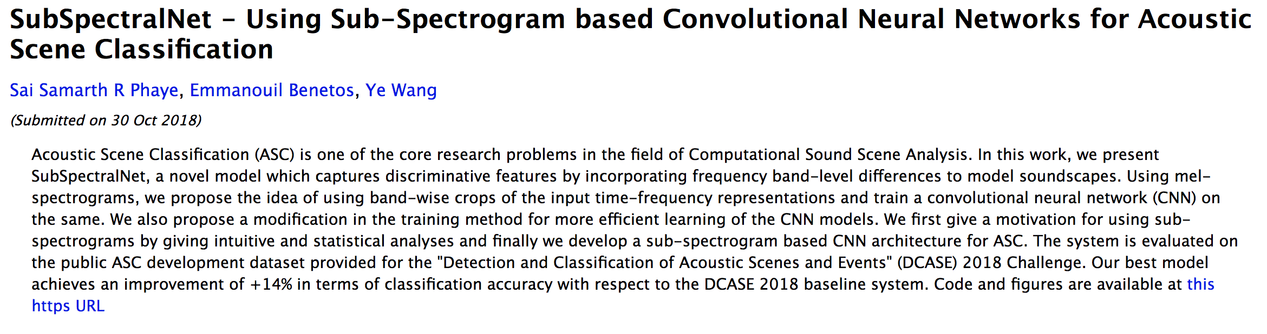
ICASSP 2019 Papers
Apple Machine Leaning Journal
Apple Machine Learning Journal
Notes:
For several classification tasks like scene classification & language detection - audio is converted to spectrum and an image inspired CNN is used for classification
Even several ICASSP 2019 papers talk about using CNN🔴
Even industry blogs mention converting audio to spectrum and using CNN for wake word detection. 🔴

Slide 5
Spectrograms are not Images
Sounds are Transparent
Axis have
different meaning
Non Local Spectral properties
Daniel Rothmann What’s wrong with CNNs and spectrograms for audio processing (2018)
Notes:
Here’s a 5 second spectrogram – any guesses what’s it. <pause>
Exactly 🔴
it’s a blues harp.
So what's wrong with treating spectrogram as an image🔴
In images a pixel can be assumed to belong to a single object. Whereas for spectrograms any point could have been produced by any number of accumulated sounds or even by the complex interactions between sound waves such as phase cancellation. This makes it difficult to separate simultaneous sounds in spectrogram representations. 🔴
In image pixels carry the same meaning regardless of their direction – moving in x or y direction should have same implication. If I move face a little up it has the same implications – whereas moving a sound vertically might influence its meaning: Moving the frequencies of a male voice upwards could change its meaning from man to child or goblin, for example. 🔴
The spectral properties of sounds are non-local.
In images, similar neighboring pixels can often be assumed to belong to the same object but in sound all the harmonics of a particular sound belong to the same object but are non locally distributed.
Images represented as pixels are similar to the way we perceive visual information using rods and cones. whereas our audio processing system is a bit more complicated.🔴

Slide 6
Are we computer vision researchers working with spectrograms ?
Notes:
More fundamentally we have to ask ourselves are as who we are ?
CNN were designed with inspiration from the human visual system. They are loosely based on how information flows into the visual cortex and were not meant to be used for audio.

Slide 7
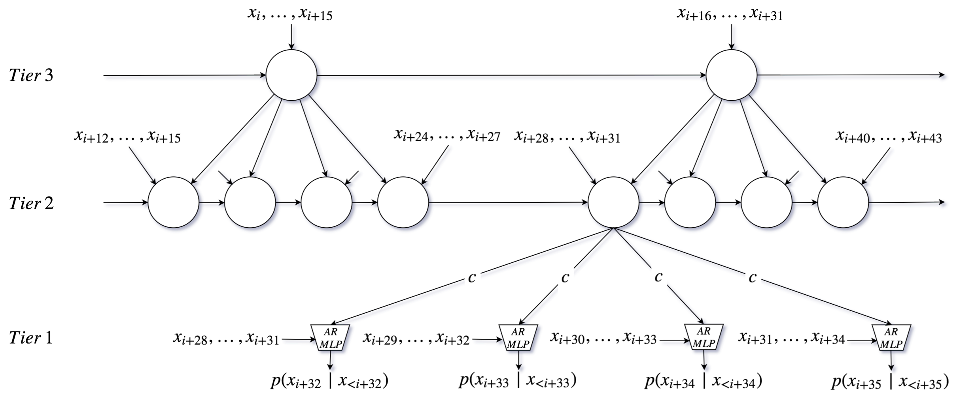
Raw Audio Synthesis
WaveNet: A generative model for raw audio (Google Deepmind)
SampleRNN: multirate RNN based generative model (MILA)
Notes:
But hope is not lost.
if we look at some of the generative networks which started appearing in 2016 we find that both these approaches are tailored towards audio.
Wavenet which achieved state of art speech synthesis results used dilated convolution accounting for higher resolution short term dependency and lower resolution longer term dependency.
Similarly SampleRNN, another state of art generator network from the MILA team use multi rate RNN operating at different resolutions. By using multiple RNNs at different sampling rate they also accounting for the temporal nature and the short/long term dependency audio has.
I believe what made these networks powerful was that they were designed for Audio
🔴

Slide 8
Low Bitrate Speech Coding
Wavenet Based Low Rate Speech Coding (Google)
W. Bastiaan Kleijn, Felicia S. C. Lim, Alejandro Luebs, Jan Skoglund,
Florian Stimberg, Quan Wang, Thomas C. Walters
High-quality speech coding with SampleRNN (Dolby)
Janusz Klejsa, Per Hedelin, Cong Zhou, Roy Fejgin, Lars Villemoes
Notes:
These generative models were so powerful that they led to breakthrough in Speech Encoding. In last few years google and Dolby have published work which drastically improve speech coding.
While google was able to achieve a really low bitrate, we were able to generate high quality speech .
In Both these approaches the bit rate has been reduced by a factor of 4x-8x while maintaining the speech quality.
Just to give you an idea as to how significant this is, the last breakthrough in speech coding was over 30 years ago in 1984 with CELP, which improved bitrate by 20-40%.
This is the biggest step function speech coding has ever seen🔴

Slide 9
Design for Audio
Notes:
We have been using our understanding of audio and speech to build better features, which we feed into CNNs. Can we design better networks ?
Developments in AI presents a big potential for smarter audio processing.
For breakthroughs in this field we need to part ways with perspectives that are inherently visual and consider new techniques based instead on our understanding of Audio.
🔴

Slide 10
Learning features
Zhu, Zhenyao, Jesse H. Engel, and Awni Hannun. Learning multiscale features directly from waveforms. (2016).
Pons, Jordi, et al. End-to-end learning for music audio tagging at scale (2017).
Ravanelli, Mirco, and Yoshua Bengio. Speaker Recognition from raw waveform with SincNet (2018)
Notes:
There has also been some brilliant work done on learning features from raw waveforms
In 2016 a multiscale confvolution front-end was proposed. These trainable filters at the front end were able to learn the frequencies they can most efficiently represent.
Jordi when he was interning with Oriol in Pandora published a paper winning the ISMIR’s best student paper”. This showed that – Showing if there’s enough data waveform-based models can get better results than spectrogram-based
What I am most exited about is the recently proposed SincNet from MILA is a waveform-based front-end based on parametrized sinc functions. They that implements band-pass filtering. With much fewer parameters (just two learnable parameters in each of its first layer filters) SincNet can outperform a spectrogram-based CNN!

Slide 11
To learn More
Wyse, Lonce. Audio spectrogram representations for processing with convolutional neural networks. (2017)
Daniel Rothmann, What’s wrong with CNNs and spectrograms for audio processing (2018)
Jordi Pons (2019)
Why do spectrogram-based VGGs suck?
Why do spectrogram-based VGGs rock?
What’s up with waveform-based VGGs?
Notes:
Hopefully this was useful and I was able to inspire at least a few of you to use your domain knowledge to design for audio instead of designing better features
If you would like to learn more the paper by Lonce is a good start. It reviews the different spectrogram representations which can be used and challenges related with them.
Daniel wrote a pretty detailed blog on what's wrong with CNN and spectrogram for audio processing.
Also Jordi wrote a series of blog post which provide a great balanced perspective on the use of spectrogram based processing.🔴

Slide 12

We are hiring !
Deep Learning Researchers
Developers & Interns
dolby.com/careers
Notes:
And if you are interested in working on challenging problems and creating audio and entertainment experiences based on Deep Learning
We are hiring in our Applied AI group – feel free to contact me if you are interested.
🔴

